Slide 1
PREDICTING MARKET VOLATILITY USING MACRO HEADLINES
Anusha P

Slide 2
INTRODUCTION & OBJECTIVE
Liquid markets are most susceptible to swings when news breaks.
Aim: To investigate how macro economic news headlines affect changes in the VIX and to predict which news stories can increase volatility.
In order to create a viable trading strategy, we need to accurately predict an increase in market volatility at least 51% of the time.

Slide 3
DATA SET
I will use over 200,000 tweets from various accounts, pulled 180,000 tweets from 70 accounts.
For market data, selected 30 companies from nasdaq website.
I predict equity market volatility using tweets from major news sources, hedge funds and investment banks, and notable economists.
I also construct my own dictionary, based on my universe of tweets, rather than using a pre-implemented dictionary.

Slide 4
ML MODELS USED
The input of the algorithm will be the word count of each bucket of tweets in a dictionary i created.
Used three different supervised learning methods:
1. Naive Bayes.
2. Support Vector Machines.
3. Logistic Regression with PCA.
Logistic Regression with PCA performed the best.

Slide 5
MODEL IMPLIMENTATION
I performed a PCA analysis on the tweets.
Used a universe of 742 clusters of tweets, and therefore performed leave-kout cross-validation to maximize the use of data.
Got prediction accuracy between 60-64%.

Slide 6
DATA PREPROCESSING
Using a subset of tweets, i created a dictionary of 10,000 words.
Tweets were grouped together in 30-minute increments, to align with intraday VIX data.
Considered only tweets between 9 am and 4pm to align with the market intra-day data.
Both Twitter data and market data is pulled over a maximum of 6 months.

Slide 7
FEATURES
Cleaned the tweets by eliminating all characters that were not letters, and eliminated URLs.
The dictionary that i used contains just over 10,000 words, which serves as our features for the algorithms.
Used 70% of the data (692 points) for training and 296 points for testing.

Slide 8
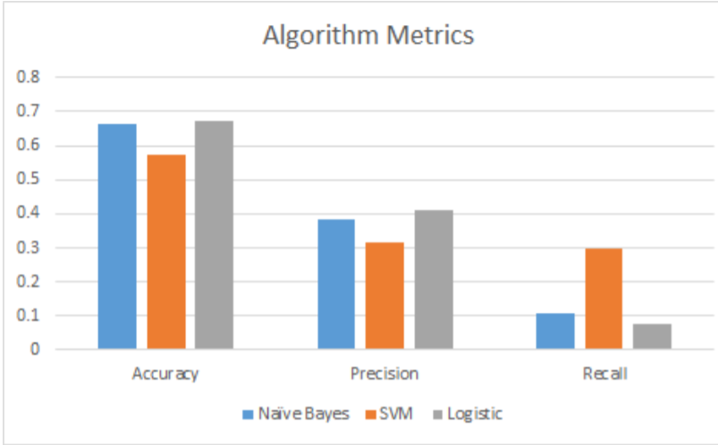
RESULTS(from the reference paper)

Slide 9
Got prediction accuracy between 60-64%.
Logistic Regression has the highest accuracy and precision, i come to the conclusion that it is the best model for the problem. It has a lower chance that the model is overfit.
The simplest strategy to trade based on this prediction is to invest in options on the VIX.
We can trade volatility by buying options on equities and hedging the underlying.

Slide 10
CONCLUSION AND FUTURE STEPS
Created a strategy that predicts movements in the VIX with above a 60% accuracy.
By implementing a 2:1 stop-loss ratio, this can be transformed into a trading strategy, using options on the VIX.
With more concentrated tweets, the accuracy would greatly increase.
By modifying and shortening the dictionary to include exclusively market related words and tokens.

Slide 11
REFERENCES
[1] Bollen, Johan; Mao, Huina; Zeng, Xiaojun. Twitter mood predicts the stock market, (2011).
[2] M.S.A Wolfram, Modelling the stock market using twitter, School of Informatics, University of Edinburgh, (2010).

Slide 12
Thank you.

